Slide 1
Laurent Dubois
Case Manager development team
September 2014
Product Implementation Training (PIT)
IBM Case Manager 5.2.1
Solution Development Improvements: Task Properties

Slide 2
Introduction
Course Overview
  Presentation of the task properties support feature introduced in ICM 5.2.1
Target Audience:
  Solution developers
  Sales, Technical Sales, Services, Support
Prerequisites:
  Familiarity with IBM Case Manager 5.2
Version Release Date: September 2014
© Copyright International Business Machines Corporation 2013. All Rights Reserved.
US Government Users Restricted Rights - Use, duplication or disclosure restricted by GSA ADP Schedule Contract with IBM Corp.

Slide 3
Course Objectives
After this course you will be able to:
Describe the usage of task properties when designing a solution
Use Case Builder with task properties
Use Process Designer with task properties
Configure auditing for task properties
List the new APIs supporting task properties

Slide 4
Course Roadmap
  Overview
  Task Properties in Case Builder
  Task Properties In Process Designer
  Auditing Task Properties
  Task properties APIs
  Use Cases
  Course Summary

Slide 5
Overview
Persist information beyond the life-cycle of the task workflow
  Task properties allow to persist workflow parameters information and make it available after the workflow is completed (workflow parameters are transient in the current process engine design and therefore lost once the workflow terminates).
  Task properties are persisted on the task object in content engine
Improve solution development and avoid using case properties as a work-around
  Previous releases only allowed to map workflow parameters to case properties (used as a way to persist workflow parameters information)
  Dedicated task properties do not pollute a case instance with properties not relevant to the case.
Synchronization between process and content engine
  Values are kept in sync between workflow, work queues and task object

Slide 6
Overview
Restrictions/limitations
  no task property support in task precondition
  no task property support in rule definition
  no task property support with custom task (user definable task within Case Client runtime)
  no task property support on container task
  no task property support with Forms
  no enhancement in Case Analyzer regarding task property modification related event & statistics

Slide 7
Course Roadmap
  Overview
  Task Properties in Case Builder
  Task Properties In Process Designer
  Auditing Task Properties
  Task properties APIs
  Use Cases
  Course Summary

Slide 8
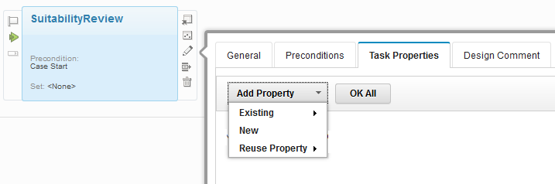
Defining Task Properties in Case Builder
Task Properties can be defined at Task level as:
  New Property
    When a new property is added at Task level, the same property will be added to solution level automatically.
  Existing Property
    Existing solution properties can be added to Task
  Reuse Property
    Properties from TOS can be added as Reused properties
Task Properties Tab - New in 5.2.1

Slide 9
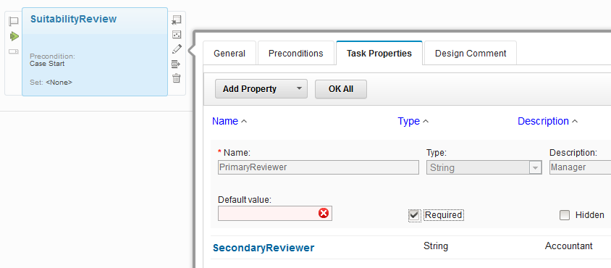
Defining Task Properties (contd...)
If the “Required” check-box is checked for a Task Property, it is mandatory to enter a default value for the Property.
  But for Case properties its not mandatory to have default value when “Required” is checked.
The default value is mandatory when “Required” box is checked

Slide 10
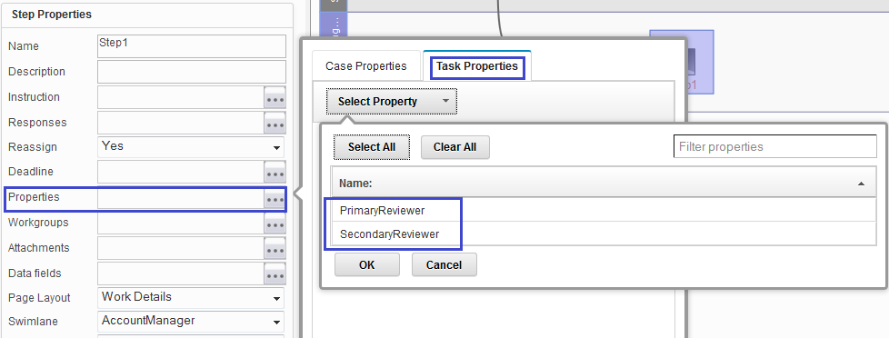
Task Properties association in Step Designer
You can choose to associate Task properties at step level in Step Designer
New 'Task Properties' tab provided along with Case properties

Slide 11
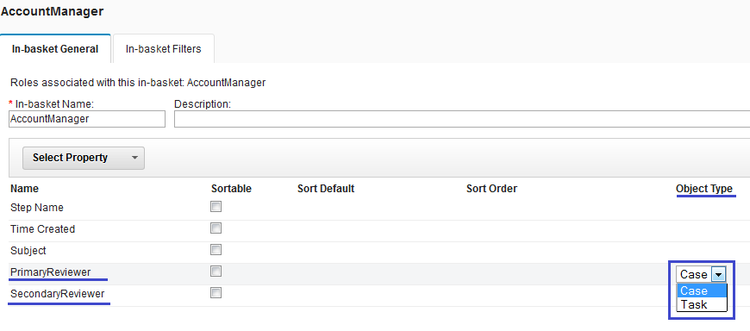
Properties “Object Type” definition in In-basket
In 5.2.0 or earlier, just Solution properties can be associated to Inbasket.
In 5.2.1, Not only you can add a Solution property to an Inbasket, but you can also define its Object Type of “Case” or “Task”.
The new 'Object Type' drop down allows to choose the “type” of a property
'Object Type' can be set to either 'Case' or 'Task'. Default is set to 'Case'.
'Object Type' selection is available at In-basket Filter level also

Slide 12
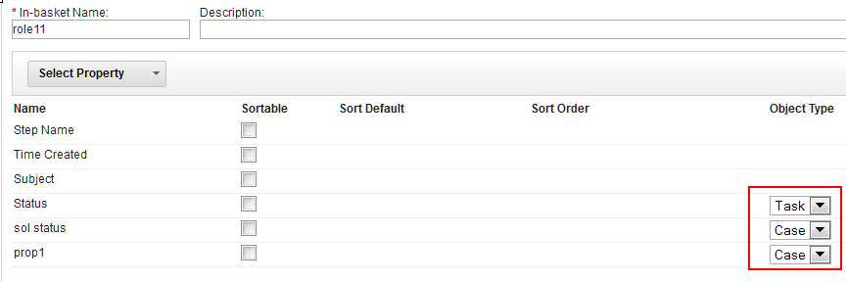
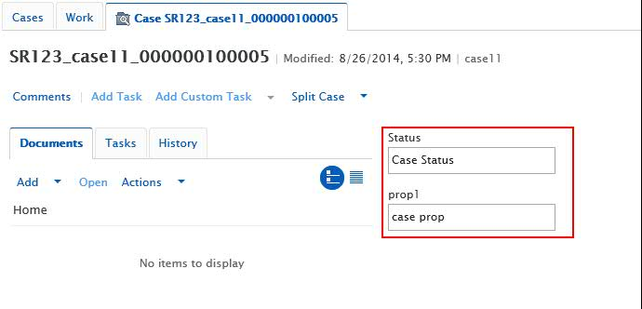
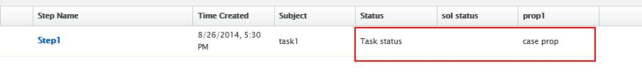
“Object Type” functionality in In-basket
The “Object Type” field will help differentiate “Case” or “Task” property when the in-basket contents are displayed in Case Client.
Depending on the property object type of “Case” or “Task”, its value will be taken from the corresponding instance.
-- For example, if a property “Status” is defined at both Case and Task levels,
  If you had chosen the option of “Case” in in-basket, then the value of “Status” available in Case instance will be shown.
  Similarly, if you had chosen the option of “Task” then “Status” value in Task instance will be shown.
  If there is no value, a blank will be shown.
Inbasket Object Types
Case Values
Task value
Blank – no value
Case value

Slide 13
Course Roadmap
  Overview
  Task Properties in Case Builder
  Task Properties in Process Designer
  Auditing Task Properties
  Task properties APIs
  Use Cases
  Course Summary

Slide 14
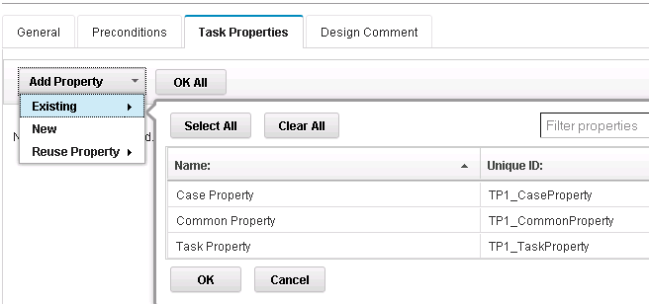
Task Properties In Process Designer
Prerequisite: add a property to a task in Case Builder

Slide 15
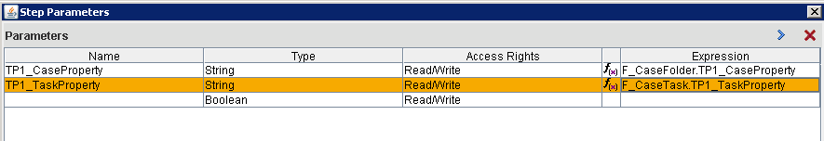
Task Properties In Process Designer
Mapping a step parameter to a task property

Slide 16
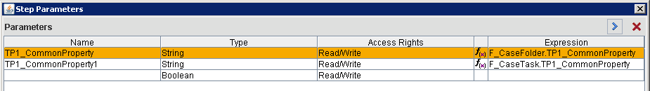
Task Properties In Process Designer
Mapping a step parameter to a task property (with an existing parameter mapping to a case property with the same name)

Slide 17
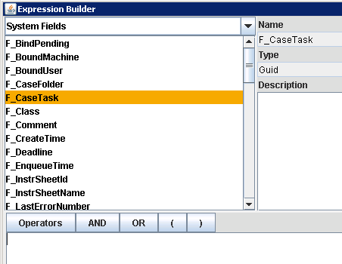
Task Properties In Process Designer
Task properties in expression builder

Slide 18
Course Roadmap
  Overview
  Task Properties in Case Builder
  Task Properties In Process Designer
  Auditing Task Properties
  Task properties APIs
  Use Cases
  Course Summary

Slide 19
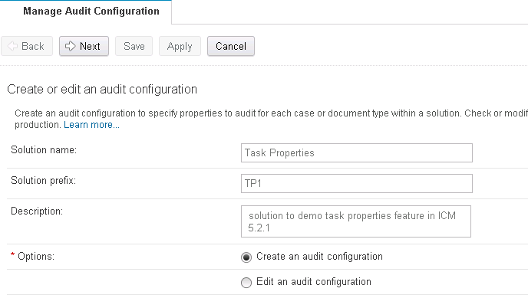
Auditing Task Properties
Configuring task properties auditing in Case Manager administration client

Slide 20
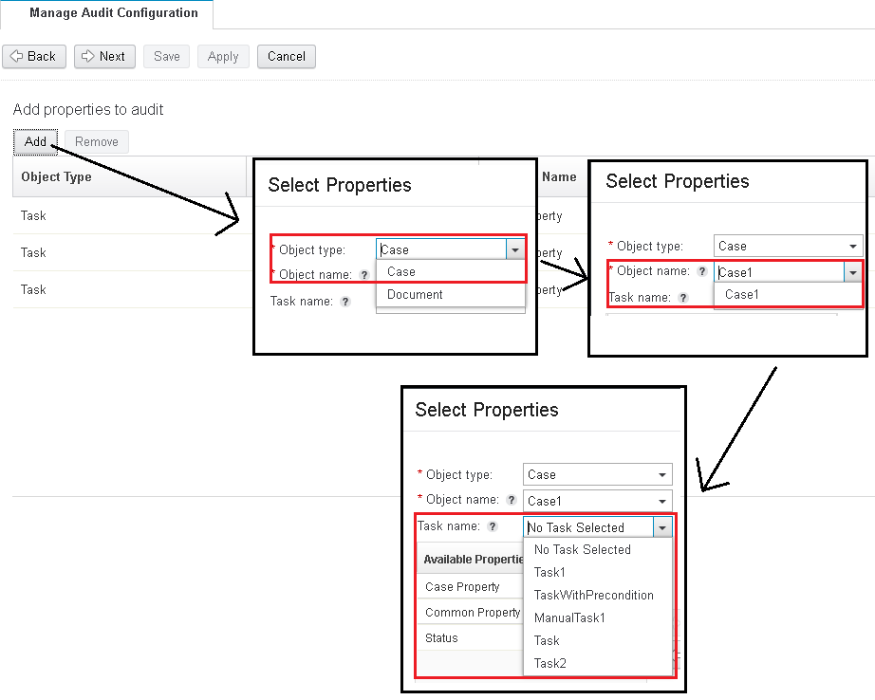
Auditing Task Properties

Slide 21
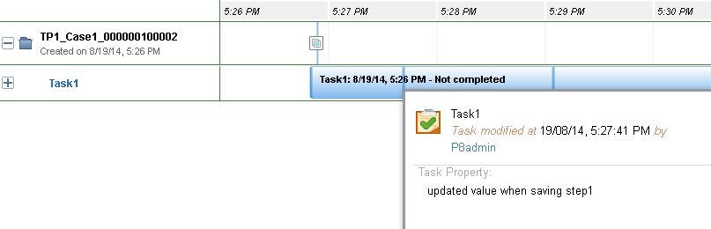
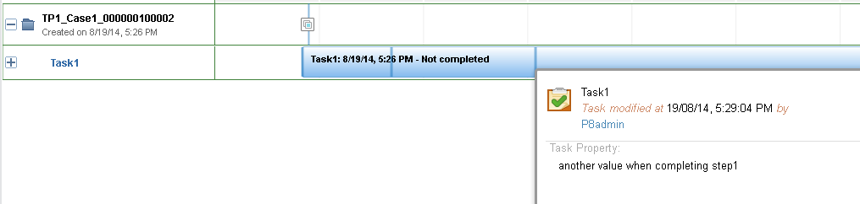
Auditing Task Properties
Audited task properties in timevisualizer

Slide 22
Course Roadmap
  Overview
  Task Properties in Case Builder
  Task Properties In Process Designer
  Auditing Task Properties
  Task Properties APIs
  Use Cases
  Course Summary

Slide 23
Task Properties APIs
Modeled after Case properties (both for java and model API)
Case Manager Java API
  New method to get properties on Task class (com.ibm.casemgmt.api.Task)
    public CaseMgmtProperties getProperties()
  Use the CaseMgmtProperties collection to modify the task properties, then call save() on the Task object to persist the changes
  New method to get unmodifiable properties on Task Class
    public UnmodifiableProperties getUnmodifiableProperties()
  Use this method for read-only access to task properties (better performance as it skips additional processing done when getting read/write properties)

Slide 24
Task Properties APIs
Case Manager Java API – step parameter provider
  Step parameters of launch steps or work items can now be mapped to task properties as well as case properties.
  Previously, mapping was only done by matching case property symbolic name to step parameter authored name.
  Now, additional attributes on the parameter configure the “provider” and symbolic name.
    It is possible for the same property symbolic name to be on task and case and both mapped to a step parameter.
  New methods on StepParameter class
    public String getPropertyProvider()
    public String getPropertySymbolicName()
  Provider is either “F_CaseFolder” for case property or “F_CaseTask” for task property.

Slide 25
Task Properties APIs
Case Manager Java API – batching
  In supporting task properties, a batching API was added
    Currently used when modifying Todo tasks. Todo tasks are discussed in a separate presentation.
    For example, properties of the Task and its parent Case can be modified at the same time, in a batch.
    Leverages the CE batching API
  A new class, com.ibm.casemgmt.api.CaseMgmtUpdatingBatch
  Certain Case Java API objects can be added to the batch
    Supports Case, Task and ExternalDocumentReference (a reference to a document in an external repository, another new 5.2.1 feature discussed in a separate presentation)
    e.g. public BatchItemHandle add(Task)
    public void updateBatch()

Slide 26
Task Properties APIs
Case Manager Model API
  New propertiesCollection attribute on the icm.model.TaskEditable object
    Contains the collection of propertyEditable objects representing task properties
    Modify propertyEditable object in the propertiesCollection and call save() on taskEditable to update and persist task properties changes.
  icm.model.PropertyEditable has new attributes: provider and symbolicName
  Batching API also exposed through a new class icm.model.UpdatingBatch
    The batch accepts these “editable” objects: CaseEditable, TaskEditable or ExternalDocumentReferenceEditable

Slide 27
Course Roadmap
  Overview
  Task Properties in Case Builder
  Task Properties In Process Designer
  Auditing Task Properties
  Task Properties APIs
  Use Cases
  Course Summary

Slide 28
Use Cases
Use task properties whenever task specific information provided during the workflow steps needs to available once the workflow is completed.
Example: Brokerage Services Suitability Review
  A Brokerage Services account (the Case) will at times during its lifecycle require a suitability review to be performed. Each suitability review is an independent task that will need to be completed whenever the appropriate preconditions are met. For both current and past suitability reviews the account owner or manager will need to know the details of each suitability review task including details such as who made the approval, what the final determination of the review was and which reviews required a second level of approval
  “approver”, “review determination” and “second level approval required” are good candidates as task properties in this example

Slide 29
Course Roadmap
  Overview
  Task Properties in Case Builder
  Task Properties In Process Designer
  Auditing Task Properties
  Task Properties APIs
  Use Cases
  Course Summary

Slide 30
Course Summary
You have completed this course and can:
Describe the usage of task properties when designing a solution
Use Case Builder to add task properties to your solution
Use Process designer to include task properties in your tasks workflows
Use Case Manager Administration Client to configure auditing with task properties
Use APIs to work with task properties

Slide 31
Contacts
Product Marketing Manager:William (Doc) Mills (wdocmills@us.ibm.com)
Product Manager: Dave Perman (dperman@ca.ibm.com)
Subject Matter Experts (SME)/Area of Expertise: Laurent Dubois (ladubois@us.ibm.com), Srinivas Jandhyala(sjandhya@in.ibm.com)
Support:Ted Dullanty (tdullanty@us.ibm.com)

Slide 32
Product Help/Documentation/Resources
IBM Case Manager 5.2.1 Knowledge Center: http://www-01.ibm.com/support/knowledgecenter/SSCTJ4_5.2.1/com.ibm.casemgmttoc.doc/casemanager_5.2.1.htm
IBM Content Navigator 2.0.3 Knowledge Center: http://www-01.ibm.com/support/knowledgecenter/SSEUEX_2.0.3/contentnavigator_2.0.3.htm
IBM FileNet P8 5.2 Knowledge Center: http://www-01.ibm.com/support/knowledgecenter/SSNW2F_5.2.0/com.ibm.p8toc.doc/filenetcontentmanager_5.2.0.htm?lang=en
IBM Support: Fix Central http://www-933.ibm.com/support/fixcentral/

